Slide 1
Security Delivery Tracker
Nicholas Fanelli
Twitter: @njfanelli_

Slide 2
Security Delivery Tracker
This tool was developed for Security Leaders, Managers and/or Practitioners to address the ongoing challenge in tracking and reporting key security metrics within their organization.
Some of these metrics include:
Product Coverage
Maturity
Return on Investment
Administrative Overhead
License Usage
Regulatory Drivers
Trending Progress
Monitor Failures
Identify Wasteful Areas

Slide 3
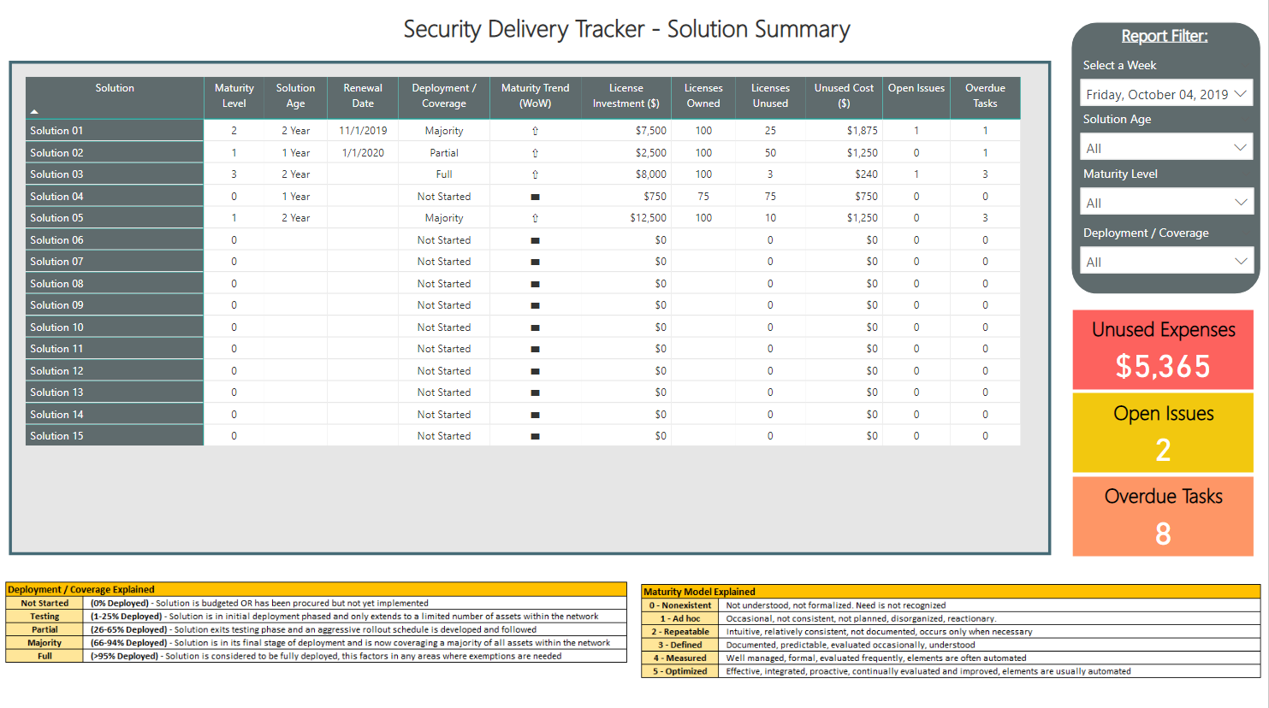
Dashboard Teaser #1
Notes:
This dashboard always leaves the viewer wanting more, in particular

Slide 4
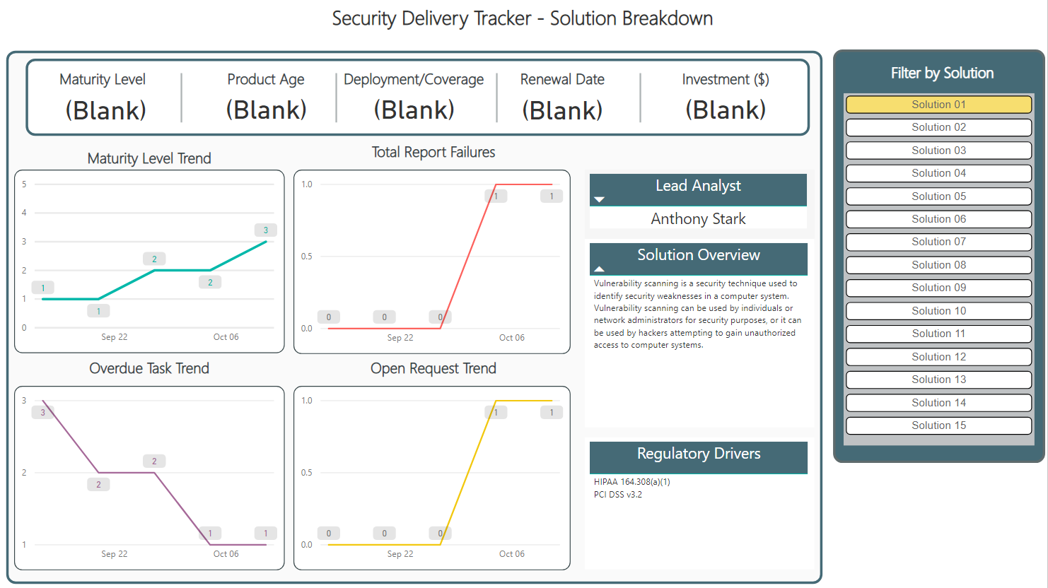
Dashboard Teaser #2

Slide 5


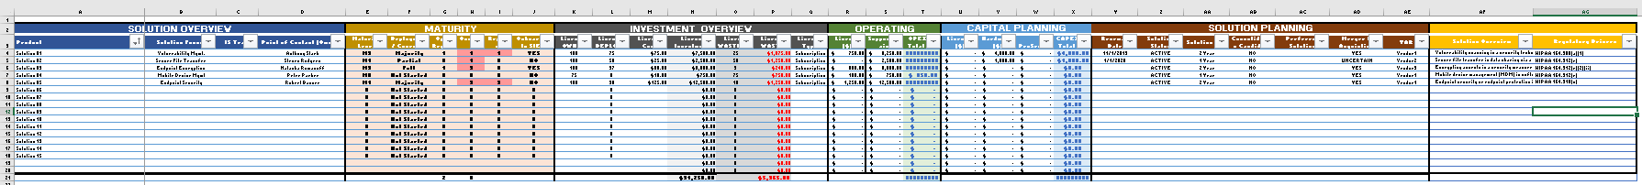
Leveraging Resources You Already Have
So what drives these dashboards?
+
OK.. This MASTER worksheet is an eye chart, lets break it down.

Slide 6
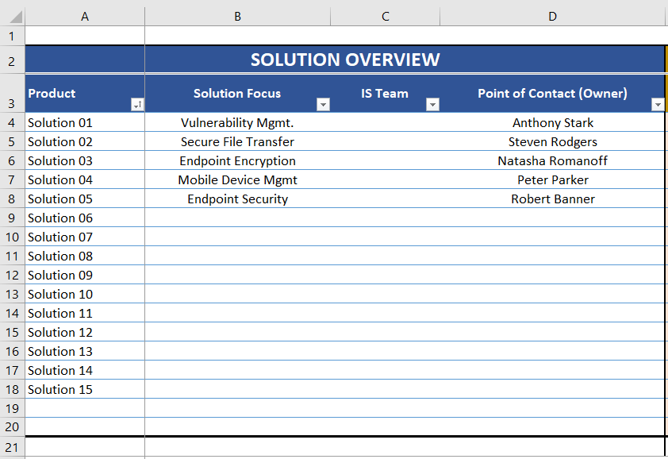
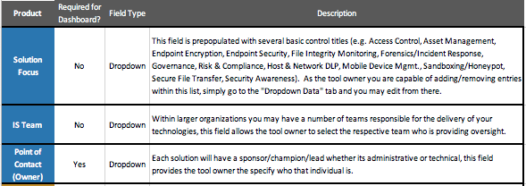
Solution Overview

Slide 7
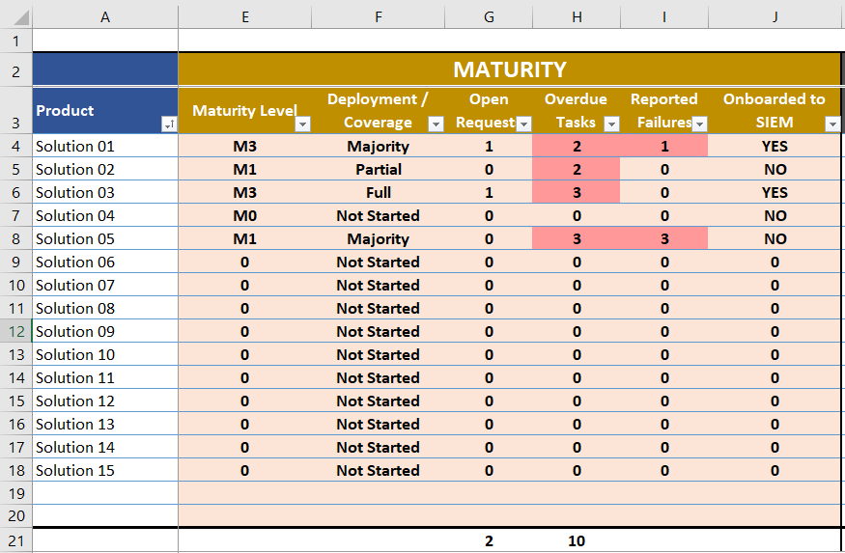
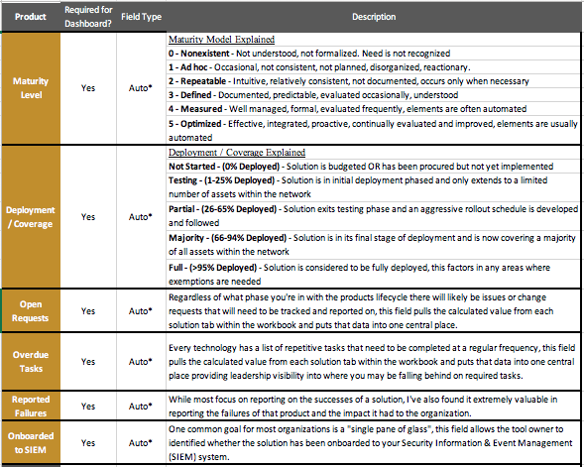
Solution Maturity

Slide 8
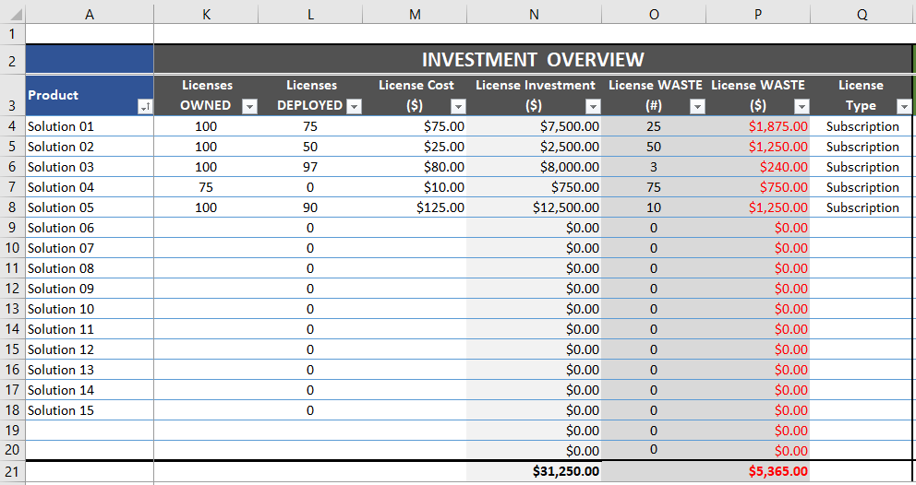
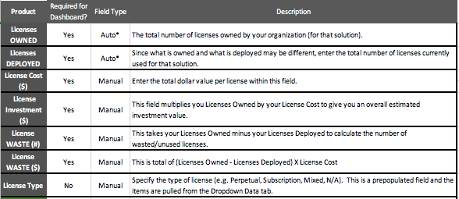
Investment Overview

Slide 9
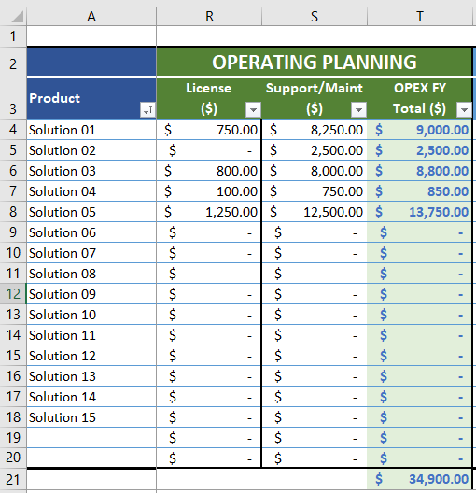
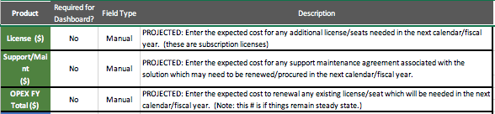
Operating Planning

Slide 10
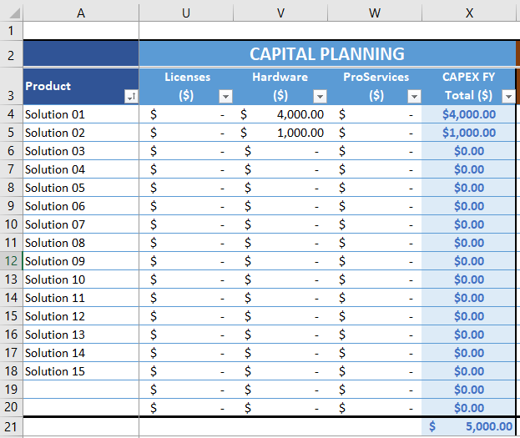
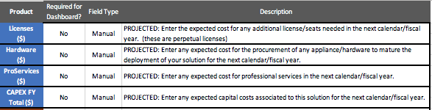
Capital Planning

Slide 11
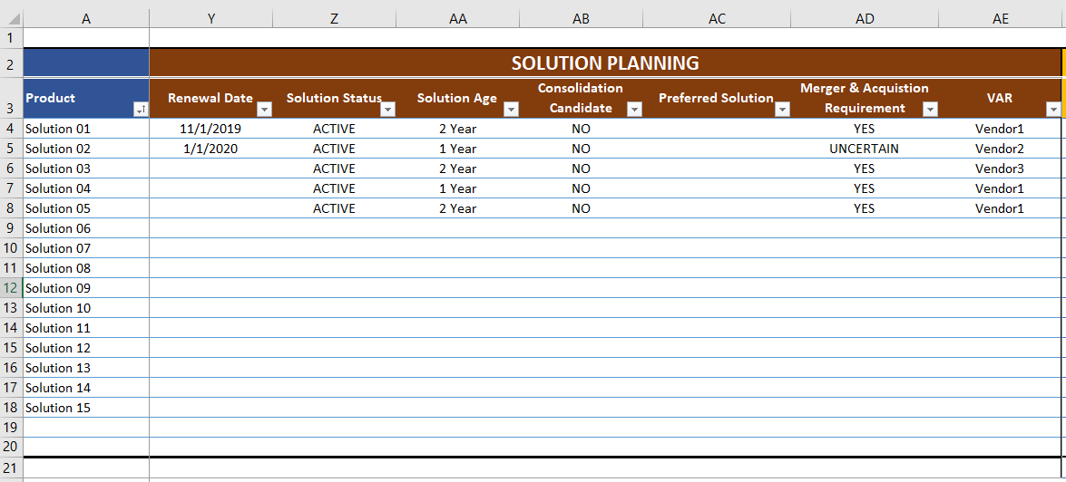
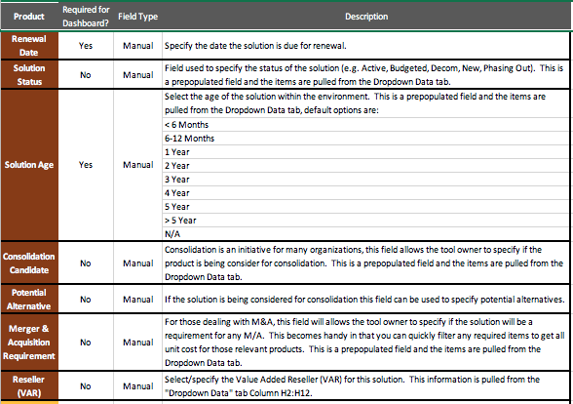
Solution Background & Planning

Slide 12
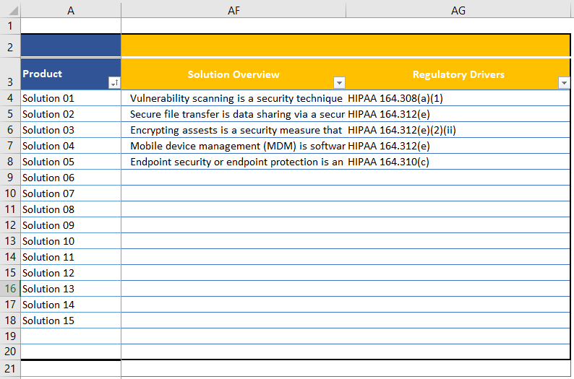

Solution Description & Regulatory Drivers

Slide 13
But Wait There Is More..
While the MASTER tab has a wealth of information this worksheet pulls information from a number of other tabs within the tool, such as...

Slide 14
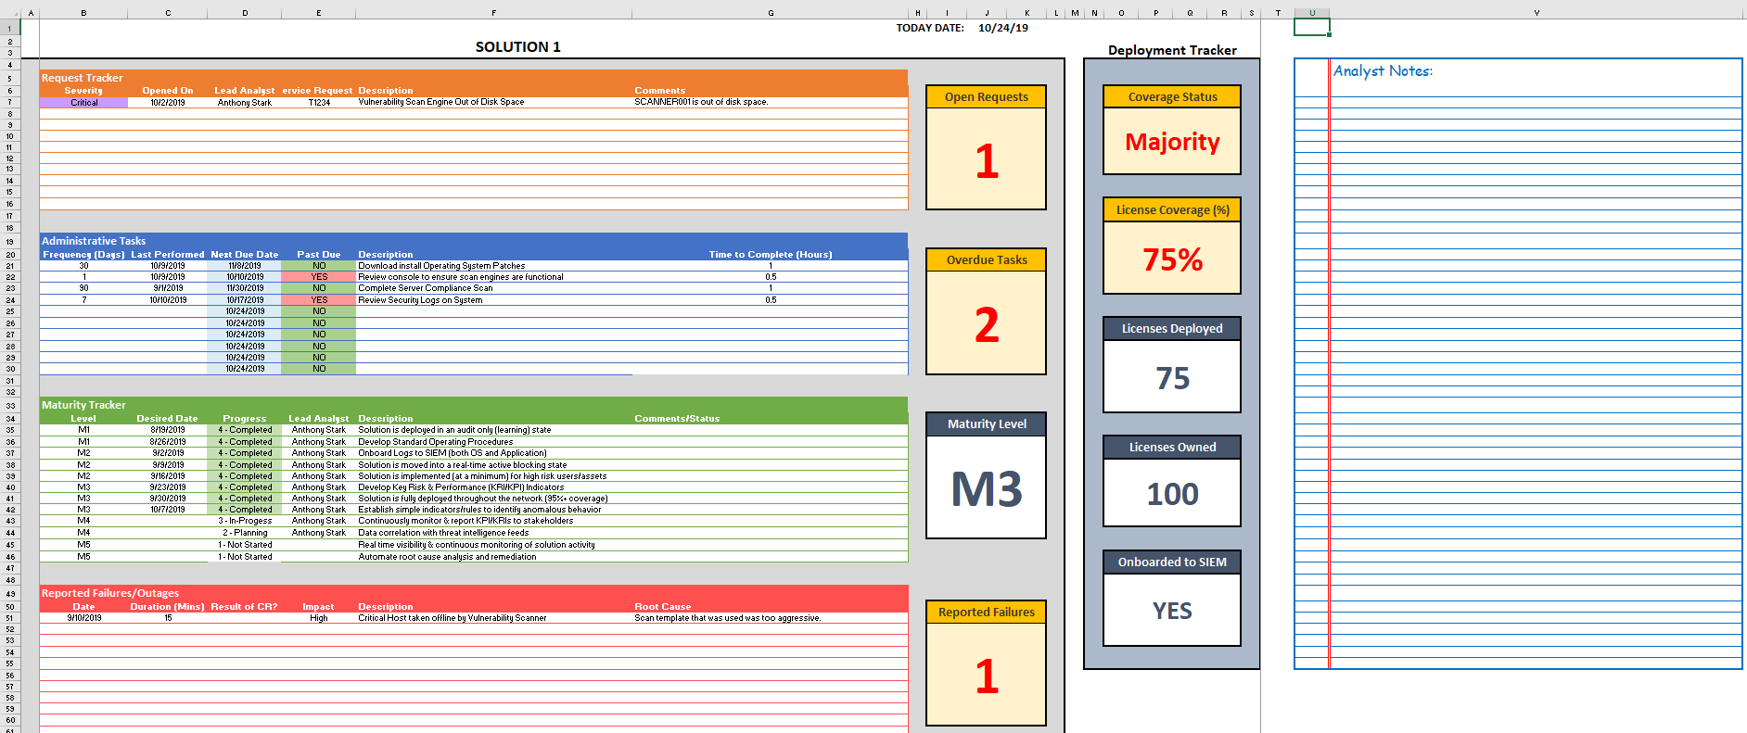
Individual Solution Tabs

Slide 15
Tracker Workflow
At a high level here’s how this works:
Manager appoints a Lead Analyst for each respective solution
Lead Analyst updates the Individual solution tab
MASTER workbook is backed up weekly
Manager launches Security Trending Data.xlsx workbook and refreshes the data query
Manager launches Security Delivery Dashboard.pbix file and refreshes the data query

Slide 16
How To Get Started?
The Security Delivery Tracker along with supplemental documentation to help get you started can be found at the link below:
https://github.com/njfanelli/Security-Delivery-Tracker
GOOD LUCK!

